Slide 1

Capstone Project: Biodiversity
Data analysis For us national parks service
Nikola Andric

Slide 2
Problem statement
Goal is to analyze data on endangered species from Bryce National Park, Great Smoky Mountains National Park, Yellowstone National Park and Yosemite National Park.
Analysis was done on the conservation statuses of the species to see whether there are any patterns to the species which are marked as endangered.

Slide 3
Data description These species belong to 2 categories which can be further divided into a total of 7 sub-categories:
.
FAUNA:
Mammals( 214)
Birds (521)
Reptiles (79)
Amphibians(80)
Fish (127)
FLORA:
Non-vascular Plants (333)
Vascular Plants (4470)

Slide 4
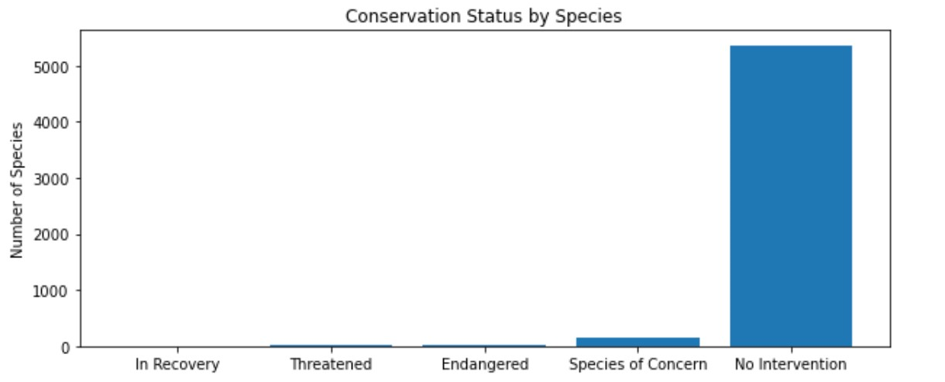
Conservation Status Most of the species are not endangered or threatened
Conservation Status | Count
Endangered | 15
In Recovery | 4
No Intervention Needed | 5363
Species of Concern | 151
Threatened | 10

Slide 5
Endangered types per species
Analyzing the groups of species gives us that:
Looking by number, it shows that birds and vascular plants are the most endangered
Looking by percent, it shows that mammals and birds are the most endangered.
The chi square test implies that the differencing in the percentage of endangerment between mammals and birds is of no significance. (0.69)
However, there is a significance in the percentages of endangerment of mammals and reptiles. (0.038)
Category | Is protected | Isn’t protected | Percentage
Amphibian | 72 | 7 | 0,088608
Bird | 416 | 75 | 0,153689
Fish | 115 | 11 | 0,087302
Mammal | 146 | 30 | 0,170455
Nonvascular Plant | 328 | 5 | 0,015015
Reptile | 73 | 5 | 0,064103
Vascular Plants | 4216 | 46 | 0,010793

Slide 6
Reason for concern?
Our initial dataset was divided into 5 categories, and for easier management it has been made into two. The approach of discarding the species which are not in danger is significant for the analysis. By aggregating the species which are not endangered into one group so that our analysis does not consider any trends (e.g. species moving from one category into another).
By taking this approoach,a clear answer is that mammals and birds deserve more focus from the conservationists.

Slide 7
Observational analysis Sheep observations: foot and mouth disease study
The staff of the Yellowstone National Park have started a new program in order to reduce this disease. The goal is to understand if the program is working with 90% confidence. To do so, the number of sheep which are required to be observed must be calculated.
Around 15% of sheep at Bryce park have foot and mouth disease. The number is believed to be the same at the other parks as well.

Slide 8
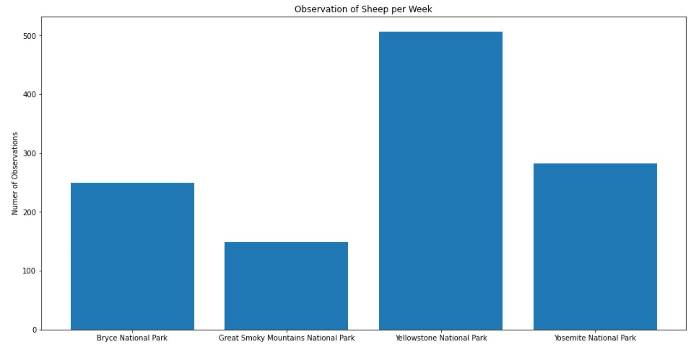
Sheep sightings
There are 3 different species of sheep found in these parks:
Ovis aries
Ovis canadensis
Ovis canadesis sierrae

Slide 9
Sample size and duration
Taking into account that 15% of sheep have FMD, the goal is to detect reductions of at least 5%. Using a simple calculation we find out that the minimal detectable effect is 33.3333%. Taking into account a standard statistical significance of 90%, we acquire the final result that it would take 870 sheep from each park
Due to the variance in the occurrence of sheep for each park, the time needed for the measurement would vary for each park:
Bryce Park 25 days (3,5 weeks)
Great Smoky Mountains National Park 42 days (6 weeks)
Yellowstone National Park 12 days (1,7 weeks)
Yosemite national Park 22 days (3,1 weeks)

Slide 10
Conclusion and discussion
Of the 3 % species listed as in danger, most of them are classified as ‘Species of Concern’
With over 15% each, Mammals and Fish are the most often classified as endangered. A very important question is whether they are indeed endangered or simply not observed as often as other species
The small number of mammals and birds (176 and 488 respectively) is also an important factor, compared to 4262 species of vascular plants
Lacking any further information about the observations of FMD in sheep, it would be of great help to analyze the the number of observations for each park adjusted for the size of each park. By doing so, we would cut the time for running the experiment, and also reduce the need for resources.

